Slide 2
About Us
Pioneers
of the prepaid payments industry
Prepaid Technologies was founded by banking industry veterans who understand the technology that is shaping the future of electronic payments.
We are a market/product driven organization with deep capabilities developing and deploying operationally excellent prepaid solutions for a variety of applications and client verticals. Our DASH suite of products solves for your complete spectrum of prepaid payment needs.
Experts
in Program Management & product configuration
Innovative
technology and advanced payment solutions
High-touch
comprehensive support with SME account management
Nimble
customized market-ready solutions

Slide 3
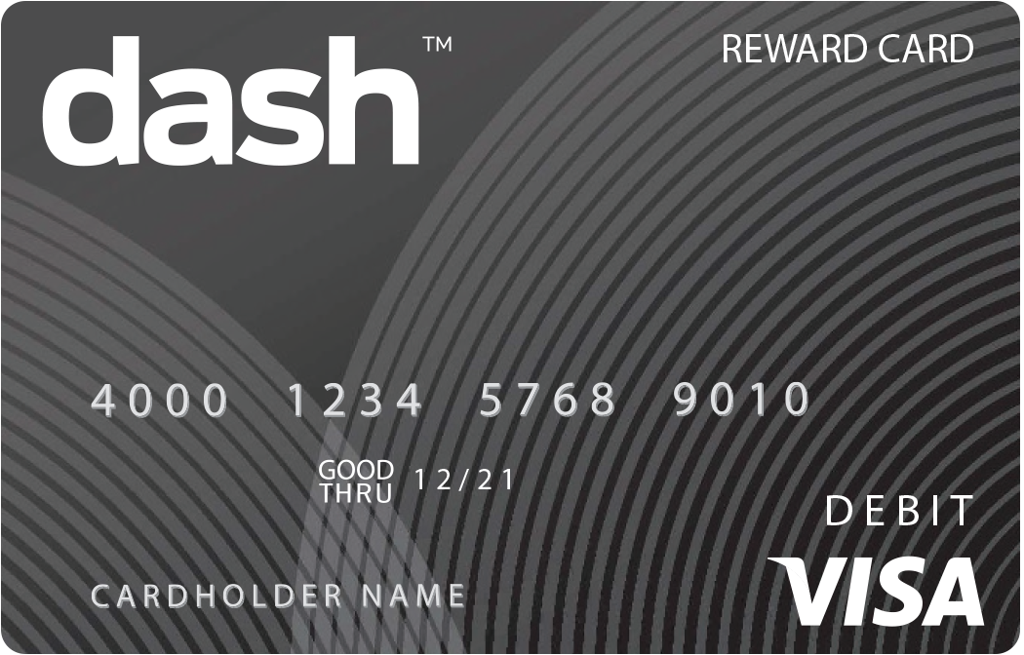
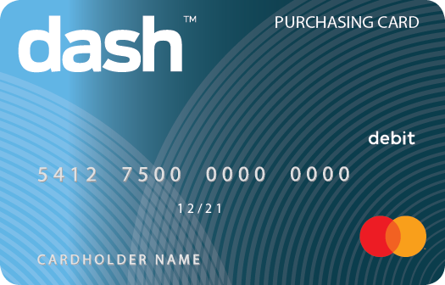
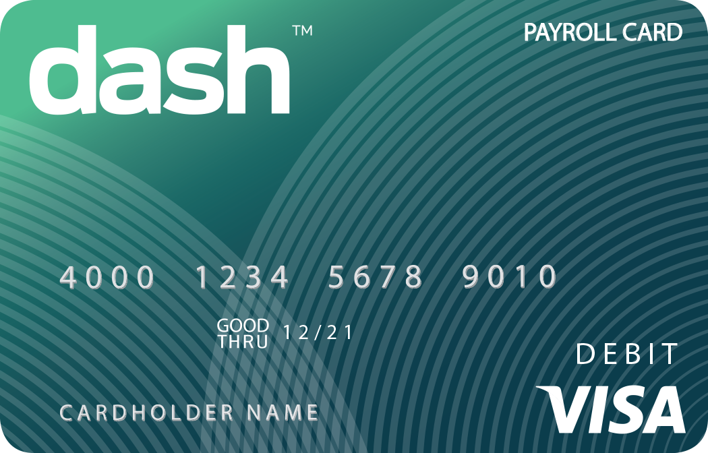
We provide the broadest suite of payment solutions that deliver a faster and more flexible payment experience for you and the cardholder:
Payment Solutions
Delivering value with “value”
Payroll
Expense & Purchasing
Disbursement & Reimbursement
Reward Solutions
Driving behaviors & business
Reward & Incentive
Promotion
Loyalty
CUSTOM SOLUTIONS: Some things don’t fit into a “box”. The dash platform provides top tier service, support and configuration tailored for your specific needs.

Slide 4
Making your wage payment practices simple, inclusive, and fast:
Consolidate Wage Payment Practices
Turnkey Administrative Solution
Feature Rich
Digital/Mobile Wallet
Savings Purse
Freeze/Replace
Spend Transparency
DASH app
100% digital process
DTC utilizing your current payroll provider
Onboarding employees and issuing cards
multiple paths
Save time & money by going electronic
Eliminate check runs
and delivery costs
No more check cashing expense
Automatic, electronic, secure payments

Slide 5
Leveraging Technology & Simplicity
There are many ways that we can support or in-stream our prepaid products into our client’s native platforms or technology stacks.
Card Management Portal:
A platform that makes managing your program simple.
Batch Order Processing:
When you need to issue and load cards quickly with minimal intervention, we provide the ability to securely transfer batch card issuance files for automatic processing.
API Connectivity:
Our comprehensive APIs enable systems to immediately interact with our processing platform, delivering real-time status and administrative functions.
Frame-In:
Our Frame-In Solution allows companies to integrate their program within the confines of their intranet, HRMS system or other native platform.

Slide 6
A Variety of Fulfillment Modes
Self Enrollment:
sponsors direct recipients to dedicated enrollment site where they self-enroll for card, receive notification of and digital or personalized cards are fulfilled directly.
Instant Issue cards:
are non-personalized cards that are ordered in bulk. When the card is ready to be issued, it can be registered through our online portal and funding can begin immediately.
Personalized cards:
are embossed with the cardholder’s name and can be delivered to the sponsor or directly to the cardholder.

Slide 7
Unique Cardholder Experience
The new dash mobile app provides a user-friendly way for cardholders to manage their money, whenever and wherever they need to.
Digital Card
Add Additional Cardholder
Replace lost or stolen card
Free Savings Account
Change PIN
Bill Pay
Freeze/Unfreeze card
ATM Finder

Slide 8
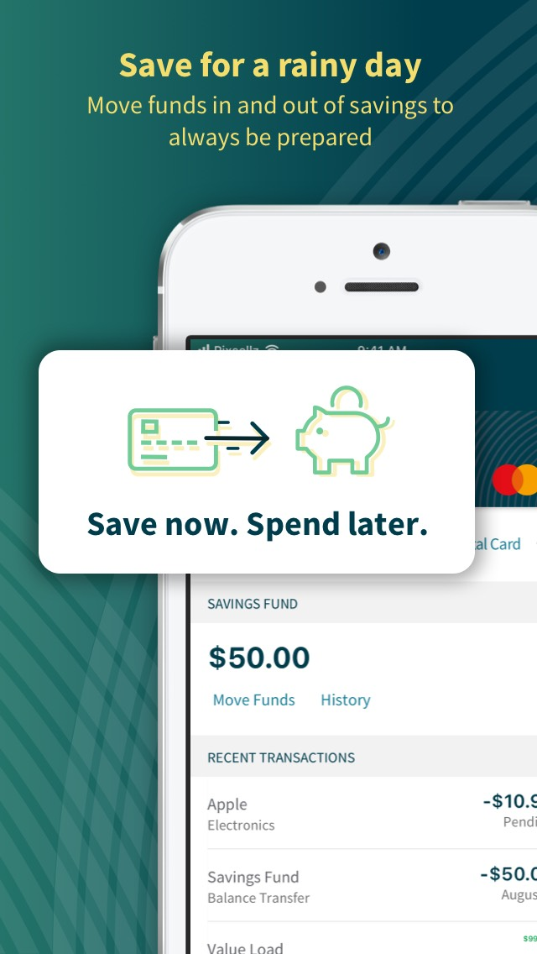
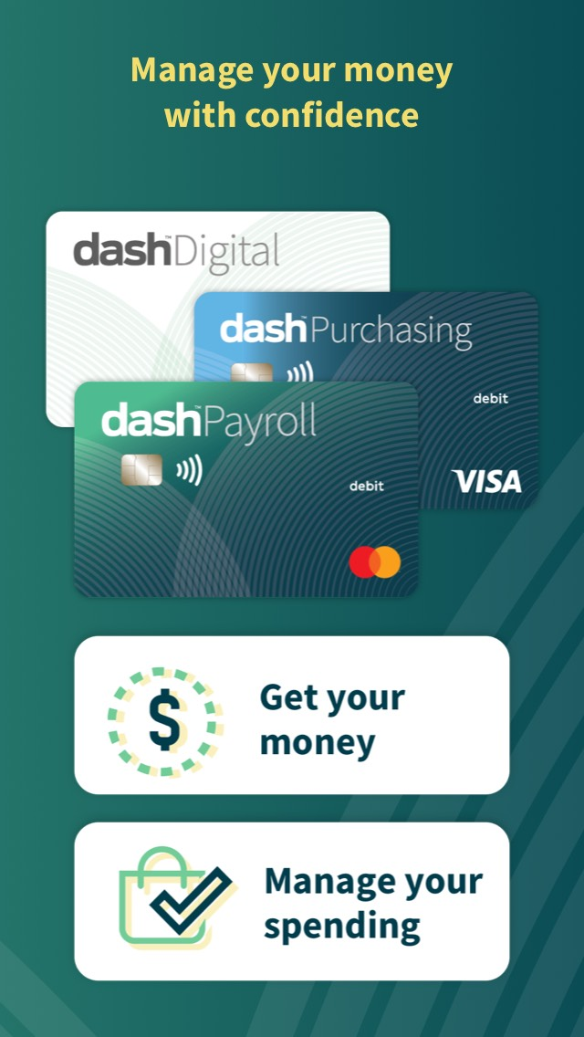
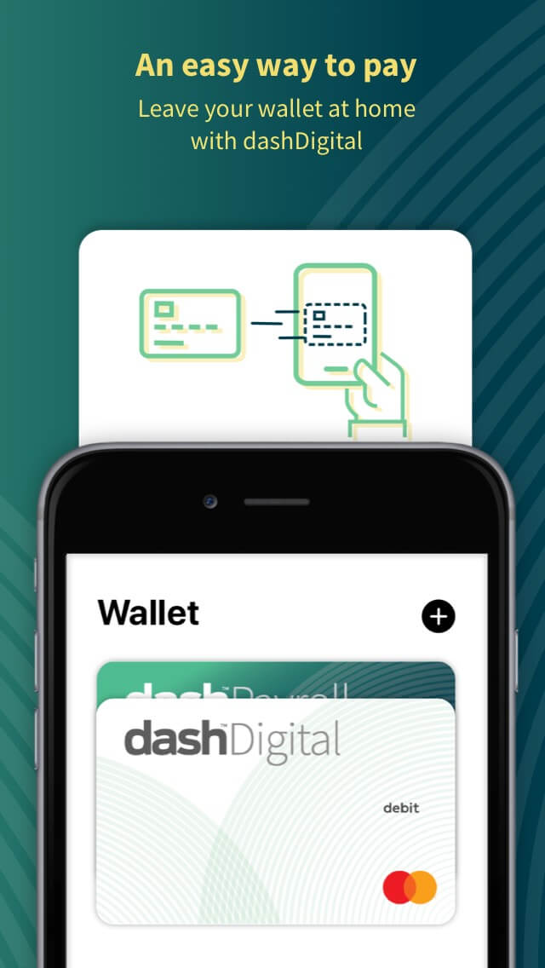
Unique Cardholder Experience
The new dash mobile app provides a user-friendly way for cardholders to manage their money, whenever and wherever they need to.
Digital Card
Replace lost or stolen card
Change PIN
Add Additional Cardholder
Free Savings Account
ATM Finder

Slide 9
Simplifying the Complex Payments Landscape
We understand that the variety of payment card options can be overwhelming. We are here to help you navigate through our diverse offerings to determine what your best course of action may be. Our nimble approach allows us to configure product attributes to your specific needs. We are the payment experts YOU can rely on!

